Slide 1
Serialization and Data Management
Pod C

Slide 2
Agenda
CSV
Pickle
JSON
SQLite
Rsync

Slide 3
CSV

Slide 4

CSV [What is it?]
CSV, which stands for Comma-Separated Values, is a simple file format used to store tabular data, including numbers and text in a plain text format.
Key Reasons:
very simple, versatile, and lightweight
compatible with most coding languages, databases, and spreadsheet applications
widely used data exchange format
universal support
Notes:
Each line in the file corresponds to a data record, and each record consists of fields, or attributes, separated by commas. This format is particularly useful for representing simple relational data.

Slide 5
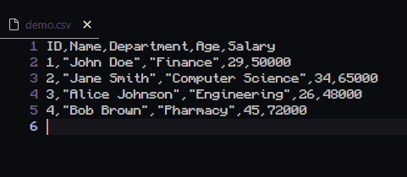
CSV [Simple Example]
CSV typically contains:
Line delimiter (ex: “\n”, “ ”)
Field delimiter (“ , “, “|”, “:”, “;”)
Quote characters (‘ “” ‘)
Optional: Header

Slide 6

CSV [Working with CSV]
To import the Python-Package for CSV:
import csv
Typically, csv (by default) should already be a pre-installed package with Python

Slide 7
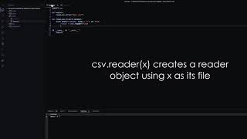
CSV [Working with CSV]

Slide 8
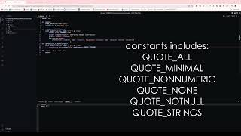
CSV [Working with CSV]

Slide 9
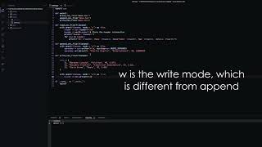
CSV [Working with CSV]

Slide 10
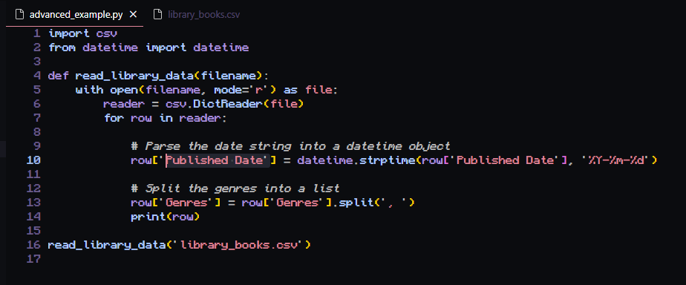
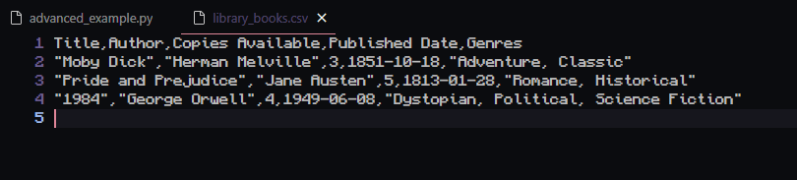
CSV [Advanced Example]

Slide 11
CSV [Best Practices]
As simple as CSV can be used, there are ways to streamline efficiency with it, such as:
Using Consistent Structure
Including Headers
Handling Missing Data Properly
Data Validation
Character Encoding
Secure Data Handling
Efficient Large File Handling

Slide 12
Pickle

Slide 13
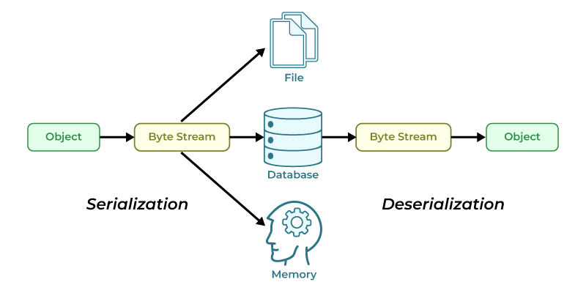
Pickle [What is it?]
Pickle is a Python-specific serialization format that implements protocols for serializing and deserializing Python objects
Serialization - Process by which an Object is converted into a byte stream
Deserialization - Process by which a Byte stream is reconstructed back into an Object

Slide 14

Pickle [Why use it?]
Pickle is absurdly powerful when it comes to Python since it provides:
Unmatched Flexibility
Preservation of Object States
Rapid Prototyping

Slide 15
Pickle [Use Cases]
Appropriate Use Cases for Pickle (in terms of our class project)
Saving and Loading Configuration Settings
Session Data Management
Caching Frequently Accessed Data
Other Use Cases for Pickle (outside of our class project)
Performance Optimization
Distributing Objects Across Python Processes

Slide 16

Pickle [Working with Pickle]
To import the Python-Package for Pickle:
import pickle
Typically, Pickle (by default) should already be a pre-installed package with Python

Slide 17
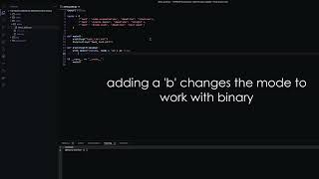
Pickle [Demo]

Slide 18
Pickle [Drawbacks]
For as powerful as Pickle is, there are subtle drawbacks that prevents Pickle from being a universally used tool
Security Concerns:
Malicious Code Execution
Limitations:
Python-Specific Format
Not Suitable for Long-Term Storage

Slide 19
JSON

Slide 20

JSON [What is it?]
- JSON is a lightweight data interchange format that’s easy for humans to read and write and easy for machines to parse and generate.
- It’s based on a subset of JavaScript but is language-independent, meaning it can be used with most programming languages.
- It’s a popular data format used in web development, data analysis, and software engineering.

Slide 21
JSON [What it isn’t]
A markup language i.e. Markdown
A programming language
A “document” format i.e. .txt
Overly complex

Slide 22
Why would someone use JSON?
JSON is easy to read and write because of its clear, structured, and lightweight syntax. It’s essentially a collection of key-value pairs, similar to dictionaries or objects in many programming languages.
JSON is not tied to any programming language. It is supported natively by many languages, including JavaScript, Python, Java, PHP, C#, and others. This makes it an ideal choice for data interchange between systems written in different languages.
JSON is the most commonly used format for web APIs. When exchanging data between web applications and servers (such as sending or receiving data from RESTful APIs), JSON is typically used because it’s lightweight and can easily represent the complex data structures needed for these interactions.
JSON’s lightweight nature means that it doesn’t carry unnecessary tags or formatting like XML does. This reduces the size of the data payload, making it ideal for transferring data in web applications, especially when dealing with bandwidth constraints.

Slide 23
Weaknesses of JSON
Limited Data Types: JSON supports basic data types like strings, numbers, booleans, arrays, and objects (key-value pairs). It does not support more complex data types like dates, tuples, or binary data directly. You may need to convert these into a supported format before serializing them.
Example: Dates must often be converted to strings in ISO 8601 format when using JSON. .{ "date": "2024-10-23T10:00:00Z" }
Lack of Schema: JSON does not natively enforce a schema, which means you can have inconsistent data. It doesn’t enforce strict data types, so errors can arise when expected data types are not adhered to.
Not Ideal for Large Data Structures: JSON becomes inefficient for very large datasets because it is text-based and not as compact as binary formats like Pickle or Protocol Buffers. Parsing and manipulating large JSON files in memory can be slow and memory-intensive.
Security Concerns: JSON, while widely used for data transmission, is vulnerable to security issues when dealing with untrusted sources. For instance, JSON data can be easily manipulated and may be used for injection attacks if not properly sanitized.

Slide 24
Use Cases for JSON (Data Exchange in APIs)
JSON is the de facto format for data exchange in RESTful APIs because it is human-readable, lightweight, and works seamlessly with JavaScript. It’s commonly used to send and receive data between client-side applications (like web browsers) and servers.
Example: Fetching user profile data from a server using a REST API
{
"name": "John Doe",
"email": "johndoe@example.com",
"age": 29
}

Slide 25
Other Use Cases
Configuration Files
Storing structured data
Client-side data storage
Logging events in structured systems
NoSQL databases for semi-str

Slide 26
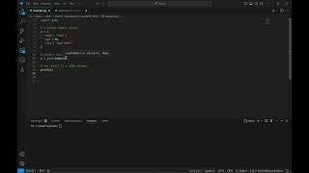
JSON Example #1

Slide 27
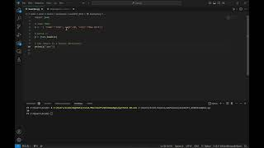
JSON Example #2
https://youtu.be/aY_YhXhqmYE

Slide 28
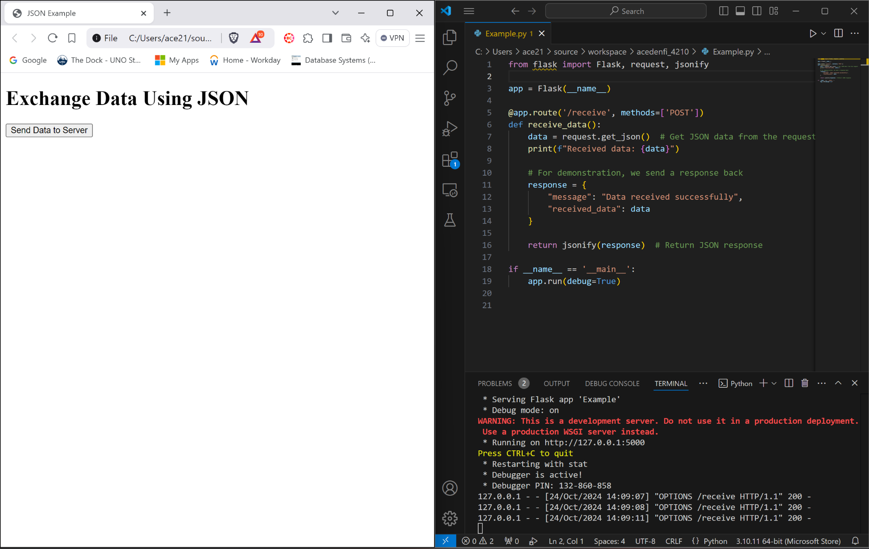
JSON Example #3
Pip install flask
Python code uses the mini framework flask to show server-client communication.
Flask allows us to hookup a html file to specific python code.
The program sends a request for data which will be sent as JSON strings and then returns that response to the server.

Slide 29
SQLite

Slide 30

SQLite [What is it?]
SQLite is a serverless, self-contained, file-based database engine.
It stores the entire database (tables, indexes, data) in a single file.
It's a great choice for small to medium-scale applications, embedded systems, and local storage needs.

Slide 31
Advantages of SQLite
Zero configuration, no separate server process.
Lightweight and easy to embed in applications.
ACID-compliant, ensuring reliable transaction support.
Well-suited for small projects, mobile applications, or local storage

Slide 32
Weaknesses of SQLite
Limited Scalability: SQLite is designed for low to medium traffic environments and may struggle with high volumes of concurrent writes.
SIngle-File Storage: SQLite stores the entire database in a single file. This can become an issue with very large databases (tens of GBs or more), as file corruption risks increase, and backups or migrations can be slow.
Limited Features Compared to Full-Fledged Databases: QLite lacks certain advanced database features, such as: Full-text search (although available through extensions). Replication and clustering. User-defined roles and permissions. Stored procedures and triggers (limited trigger support).
In-Memory Database Size Limitations: SQLite is limited by available RAM for in-memory databases. The entire database must fit in memory, which limits the size of in-memory databases based on the system's hardware.

Slide 33
Use Cases for SQLite
Embedded Applications: Ideal for embedded systems, mobile devices, and desktop applications. Many Android and iOS apps use SQLite for storing user data locally, such as preferences, logs, or small data sets.
Local Storage in Web and Desktop Apps: Storing data locally for small-scale web or desktop applications.
Prototyping and Development: Useful for quickly testing SQL queries and database logic during the early stages of development. Developers use SQLite to prototype database interactions without setting up a full DBMS like MySQL or PostgreSQL.
IoT Devices: Storing sensor data or configuration data locally on small IoT devices (e.g., Raspberry Pi). A Raspberry Pi used to collect temperature sensor data stores it in an SQLite database before syncing it to the cloud.

Slide 34
Setting up SQLite in Python
SQLIte is often pre-installed on many systems.
Python comes with an sqlite3 library as part of its standard library, so no additional installation is required. (pip install sqlite3)

Slide 35
Connecting to SQLite Database
SQLite uses a file-based approach where the database is stored in a file. A new database file will be created if it doesn’t already exist.
import sqlite3
# Connect to SQLite (this creates the file if it doesn't exist)
connection = sqlite3.connect('example.db')
# Create a cursor to interact with the database
cursor = connection.cursor()
print("Database connected!")

Slide 36
Creating Tables(Schema Definition)
# Create a table
cursor.execute('''CREATE TABLE IF NOT EXISTS students (
id INTEGER PRIMARY KEY,
name TEXT NOT NULL,
age INTEGER,
grade TEXT
)''')
connection.commit() # Commit the changes to the database
print("Table created successfully.")

Slide 37
Inserting Data
# Insert data into the table
cursor.execute("INSERT INTO students (name, age, grade) VALUES (?, ?, ?)", ("Alice", 20, "A"))
connection.commit() # Commit the transaction
print("Record inserted successfully.")

Slide 38
Fetching/Filtering Data
Fetching Data: # Fetch all records
cursor.execute("SELECT * FROM students")
rows = cursor.fetchall()
for row in rows:
print(row)
Filtering Data: # Fetch specific records with a WHERE clause
cursor.execute("SELECT * FROM students WHERE grade = 'A'")
rows = cursor.fetchall()
for row in rows:
print(row)

Slide 39
Updating Data
# Update student data
cursor.execute("UPDATE students SET age = ? WHERE name = ?", (21, "Alice"))
connection.commit() # Commit the transaction
print("Record updated successfully.")

Slide 40
Deleting Data and Closing the Connection
# Delete a record
cursor.execute("DELETE FROM students WHERE name = ?", ("Bob",))
connection.commit()
print("Record deleted successfully.")
connection.close()
print("Database connection closed.")

Slide 41
Rsync

Slide 42

What is Rsync?
Rsync is a Linux-based tool that can be used to sync files between remote and local servers. Rsync has many options that can help you define the connections you make.
Rsync is an open source file synchronization program. Its designed to maintain a mirror of a directory. It is a very advanced tool and an intelligent data-transfer algorithm that can be used to make backups, or to copy files to another disk.

Slide 43
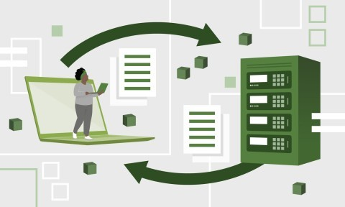
Why is it used?
Efficiency: if a version of a file already exists at the destination, it only changes portions that are transferred. This greatly reduces resource requirements and elapsed time especially with large files. It detects redundancies which minimizes network load.
Robustness: in environments with slow connections or random hardware failures (especially disks that become non-operational after heating up), rsync can resume transfers that were interrupted

Slide 44
What to Download
Mac: it is already installed
Linux - RPM-based Linux machine-> sudo yum install rsync
Debian-based Linux machine-> sudo apt-get install rsync
Windows- https://www.youtube.com/watch?v=K96n-Es4kTs

Slide 45
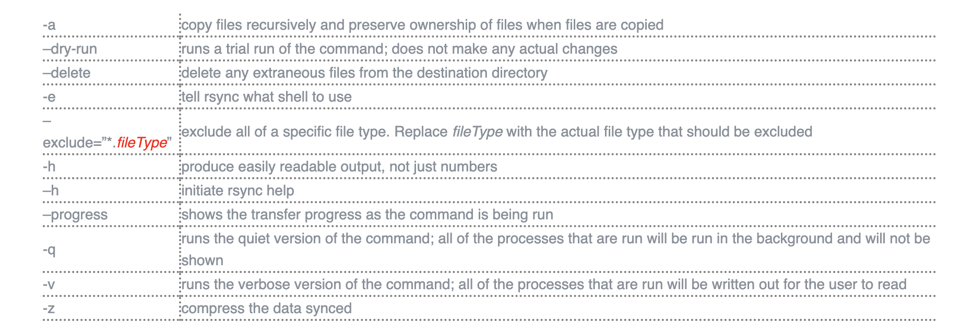
RSYNC flags and utilities

Slide 46
Using Rsync
Play video-
https://youtu.be/WtBtq429ki0

Slide 47
Deliverables:
Create a file using one of the featured formats that includes your pod’s ID, pod description, and pod members and push it to the github!

Slide 48


